Slide 1
Prediction of Metabolic Syndrome Using Machine Learning
Author: Yvon Bilodeau
April 2022

Slide 2
Project Description
The goal of this project is to predict the presence of metabolic syndrome, positive or negative, based on common risk factors utilizing categorical machine learning.
"Metabolic syndrome is increasingly common, and up to one-third of U.S. adults have it. If you have metabolic syndrome or any of its components, aggressive lifestyle changes can delay or even prevent the development of serious health problems."
Source - Mayo Clinic

Slide 3
Project Data Source
The dataset was sourced from Data.World.
Data.World acquired the data for this analysis from the NHANES, National Health and Nutrition Examination initiative, in which several features were combined from multiple tables.
The dataset consists of 2401 rows, and 15 columns.
The rows represent 2401 observations, and the columns represent 14 features and 1 target variable.

Slide 4
Project Data Feature Descriptions
Data | Description
seqn | Respondent sequence number
Age | Age in years
Sex | Male or female
Marital | Marital status
Income | Income in dollars
Race | Racial Group
WaistCirc | Waist circumference (cm)
Data | Description
BMI | Body Mass Index (kg/m**2)
Albuminuria | Albumin in Urine (mg/L))
UrAlbCr | Ratio of Albumin (mcg/L) to Creatinine (mg/L) in Urine
UricAcid | Uric Acid in Blood (mg/dl)
BloodGlucose | Glucose in Blood (mg/dL)
HDL | High Density Lipoprotein (mg/dl)
Triglycerides | Triglycerides in Blood (mg/dL)

Slide 5
Metabolic Syndrome Diagnosis
"The National Institutes of Health guidelines define metabolic syndrome as having three or more of the following traits, including traits for which you may be taking medication to control:
Large waist — A waistline that measures at least 35 inches (89 centimeters) for women and 40 inches (102 centimeters) for men
High triglyceride level — 150 milligrams per deciliter (mg/dL), or 1.7 millimoles per liter (mmol/L), or higher of this type of fat found in blood
Reduced "good" or HDL cholesterol — Less than 40 mg/dL (1.04 mmol/L) in men or less than 50 mg/dL (1.3 mmol/L) in women of high-density lipoprotein (HDL) cholesterol
Increased blood pressure — 130/85 millimeters of mercury (mm Hg) or higher
Elevated fasting blood sugar — 100 mg/dL (5.6 mmol/L) or higher“
Source - Mayo Clinic

Slide 6
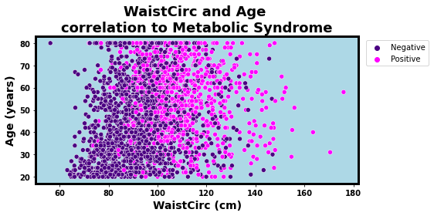
Waist Circumference and Age correlation to Metabolic Syndrome
Large waist
- A waistline that measures at least 35 inches (89 centimeters) for women and 40 inches (102 centimeters) for men is one of the predictive traits for Metabolic Syndrome.

Slide 7
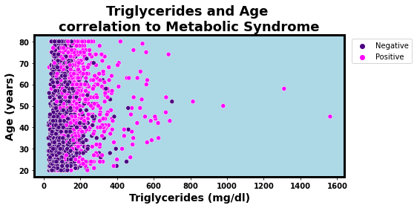
Triglercides and Age correlation to Metabolic Syndrome
High triglyceride level
- 150 milligrams per deciliter (mg/dL), or 1.7 millimoles per liter (mmol/L), or higher of this type of fat found in blood is one of the predictive traits for Metabolic Syndrome.

Slide 8
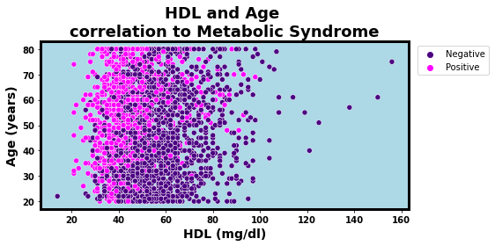
HDL and Age correlation to Metabolic Syndrome
Reduced "good" or HDL cholesterol
- Less than 40 mg/dL (1.04 mmol/L) in men or less than 50 mg/dL (1.3 mmol/L) in women of high-density lipoprotein (HDL) cholesterol is one of the predictive traits for Metabolic Syndrome.

Slide 9
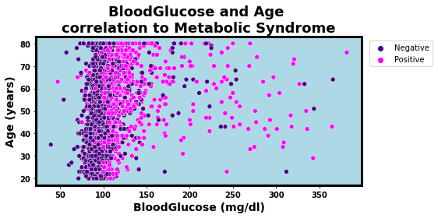
Blood Glucose and Age correlation to Metabolic Syndrome
Elevated fasting blood sugar
- 100 mg/dL (5.6 mmol/L) or higher is one of the predictive traits for Metabolic Syndrome.

Slide 10
Model Selection and Evaluation
The Random Forest Model is the recommended model.
It was chosen for having a 88.3% accuracy rate in predicting metabolic syndrome, the highest of the models that were evaluated.

Slide 11
Recommendations Benefit or Early Diagnosis and Treatment
Accurate prediction can lead to early diagnosis and treatment. Inaccurate prediction can delay diagnosis and treatment.
"The main goals of treating metabolic syndrome are to lower your risk of heart disease and to prevent type 2 diabetes if it hasn’t already developed. If you already have type 2 diabetes, treatment can lower your risk of heart disease by controlling all your risk factors.
Heart-healthy lifestyle changes are the first line of treatment for metabolic syndrome. You may have to see a dietitian and a physical therapist to help find a diet and exercise plan that works for you. If healthy lifestyle changes do not work, you may need medicines or weight loss surgery."
Source - The Mayo Clinic

